Slide 1
INDUSTRIAL INTERNSHIP
Social Media Entertainment Website [www.pickcross.com]
By – Kunwarjeet Singh (12MSE1086)
Bakar Technologies, New Delhi

Slide 2
Abstract
We are going to develop a Social Media Entertainment Website where users can upload and share content either user-generated or found on other social media websites. 9gag is our current competitor which is widely used for content sharing. Currently in India we don’t have any strong competitor. Online meme creator is not that flexible, so still some users have to create using offline tool. Our Meme Generator tool is very flexible for creation of memes and we also allow user signature. Our main aim is to capture Indian market and allow advanced creation of memes by users.

Slide 3
Modules
Login/register: Login using social networking sites or email registeration.
Trends Tag Managements: Latest Tags will be idenetified and accordingly content will be displayed.
Meme Generator: Online tool for advanced meme creation.
Content Sharing: Users can share content to other social media websites like Facebook, Twitter, Google+, Watsapp.
CMS: Track of each user action such as like, comment is recorded.
Reward System: User will be rewarded for each activity – points system.
User Profiles: Activities done by user will be shown here. He may edit/update his info.

Slide 4
Modules
Main page view: Different type of tags, top trending, fresh..
Tags view/Search view: A proper search mechanism is there and results are filtered by tags.
Content Detailed View: Detailed view of a content, commnets, upvotes, down votes, pscore and other related info.
Admin Panel: A proper admin panel is there to manage users, content, tags, and UI.

Slide 5
Responsive Design
Task was to create a fully responsive UI
Responsive to all screen sizes.
Bootstrap Framework was used to fulfil this requirement.
Functionality differs as screen size vary.
Mobile and Tablet Responsive

Slide 6
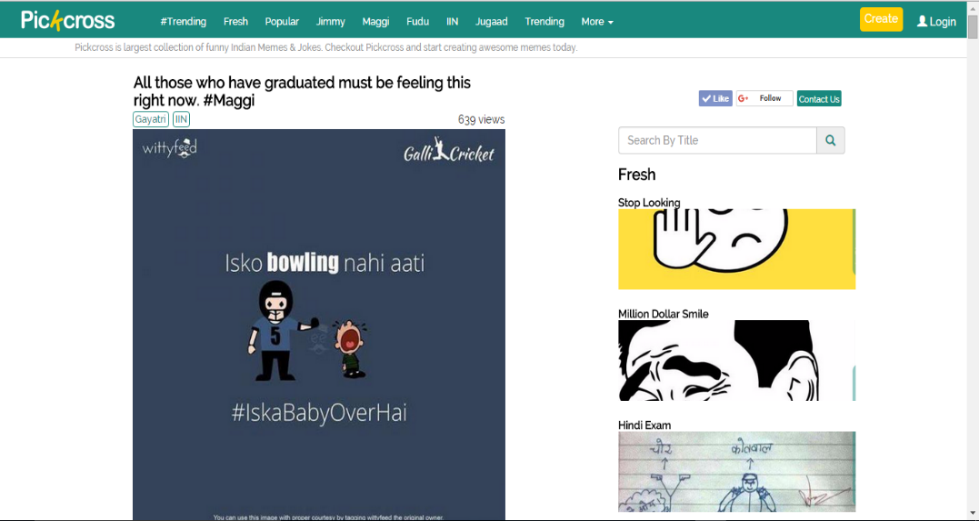

Slide 7
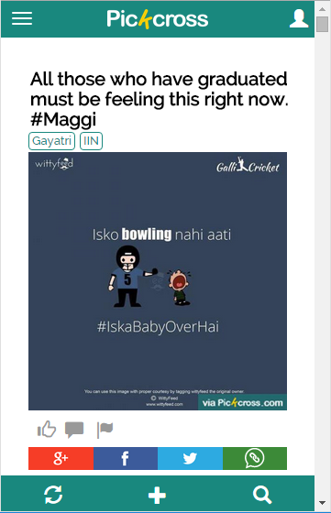
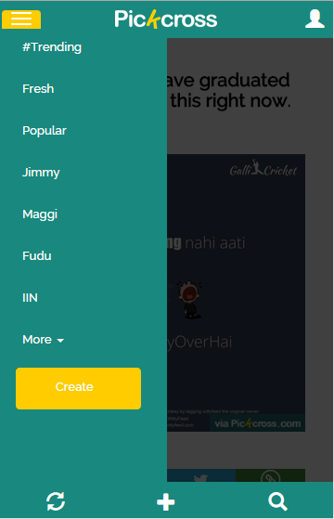

Slide 8
Dynamic Search
AJAX was used for providing dynamic search.
Views inside a search were created again using Bootstrap so Responsive + Dynamic according to screen size.
Search view in mobiles differs to that in PC.

Slide 9
Meme Generator Tool
Meme generator is our content-creator tool made using full JavaScript and JQuery for faster working as content has to be displayed dynamically as values changes.
Features such as include top and bottom padding.
Black/White Color choice.
Increase/Decrease Font Size
Signature Option
Download – Submit - Share

Slide 10
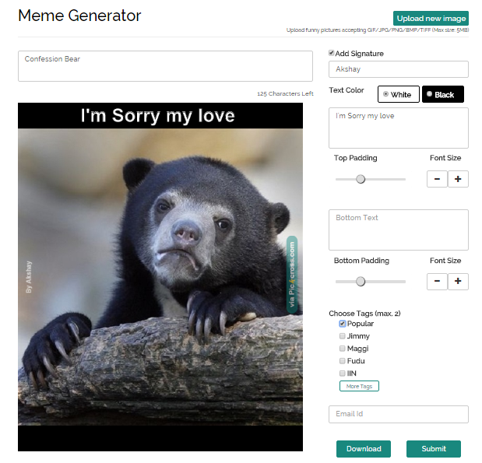

Slide 11
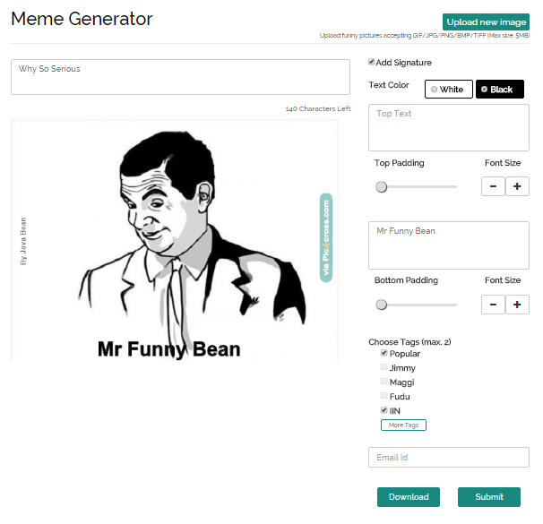

Slide 12
Social Login
This was one of the trickiest as to provide secure login functionality using Social accounts such as Facebook and Twitter.
OAuth Token based authentication.

Slide 13
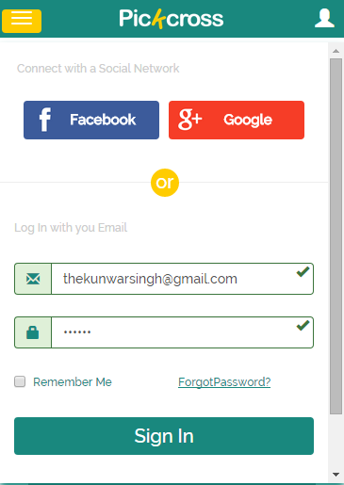
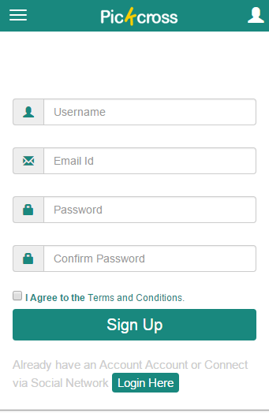

Slide 14
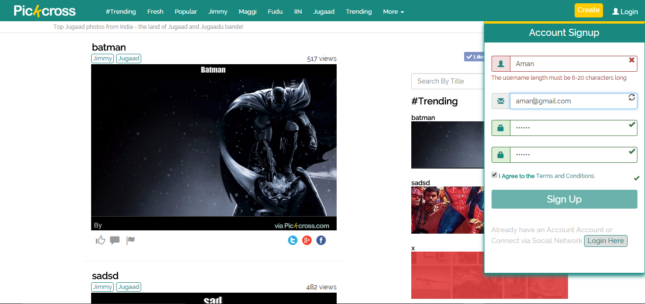

Slide 15
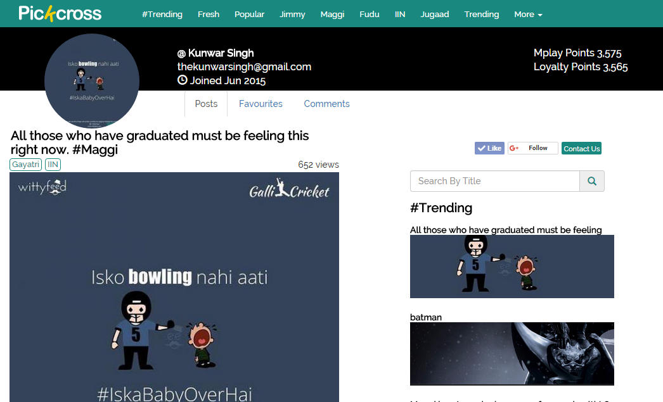

Slide 16
Admin Panel
Admin panel was created to manage users, content, tags and UI. Dynamic tag maintenance was one of the trickiest part.
User Maintenance – Delete, Edit user roles.
Content Maintenance – is Visible, Change Tags etc.
Web UI Maintenance – Tags Maintenance, Change tags order in navbar.

Slide 17
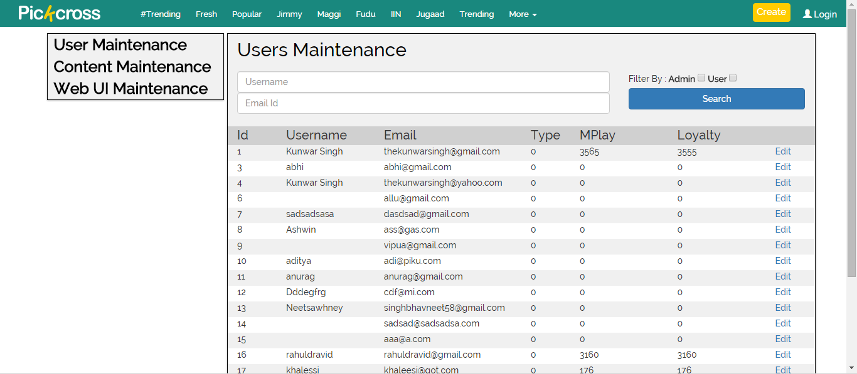

Slide 18
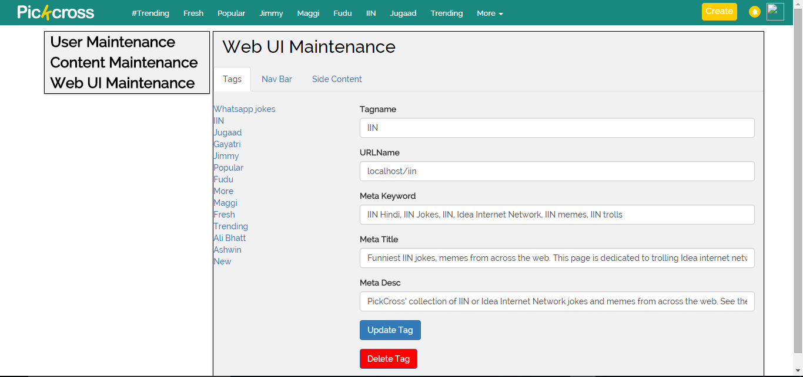

Slide 19
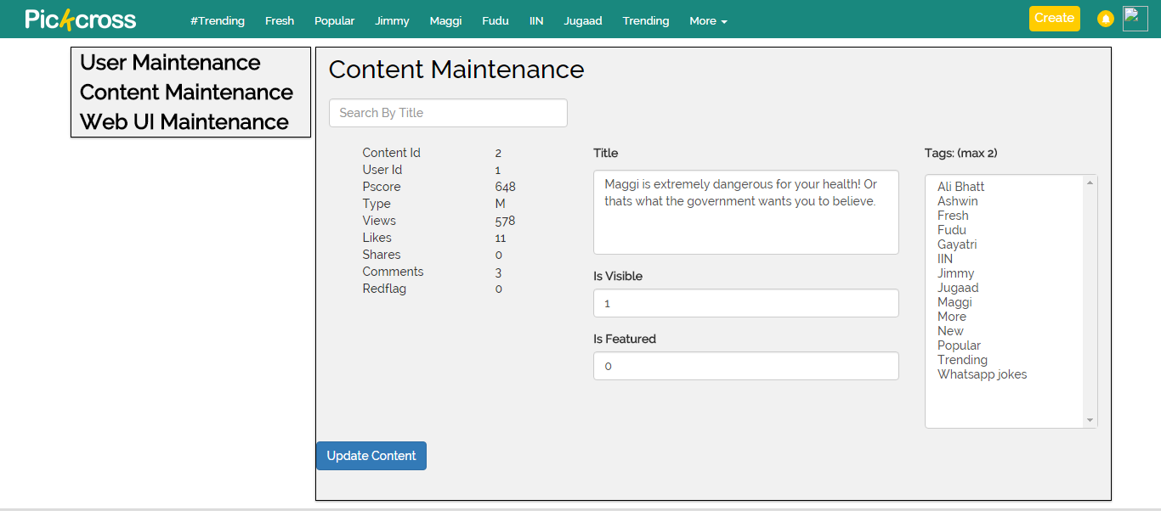

Slide 20
Software tools used
Google Compute Engine
Notepad++ text editor
Netbeans
Php Laravel Framework
LAMP Stack

Slide 21
Languages to be used
HTML5 , CSS3 , Bootstrap Framework
JavaScript , JQuery , AJAX
PHP, Laravel Framework, Eloquent
MySQL

Slide 22


Slide 23


Slide 24
Thank You

